Slide 1


Android Game Development 101
How I Learned to Love the Canvas

Slide 2
Agenda
Android – A Gaming Platform
Game Design 101
Game Programming 101
Android for Game Developers
Lunch Break (Ohm Nom Nom Nom)
Droidanoid

Slide 3
Before We Start
Eclipse http://www.eclipse.org/
Android SDK & ADT http://developer.android.com/sdk/installing.html
Google Code Page (slides & sources): http://code.google.com/p/agd-101/
See video on how to perform the setup.

Slide 4
1 - Why Develop for Android?
~300k activations per day == huge audience.
Instant push to gamers via Android Market.
One time fee of 25$ to become a publisher.
No walled garden.
Free Development Tools.
Eclipse, Java (erm Dalvik…), Android SDK, ADT
Hardware rivaling dedicated gaming platforms, e.g. Gameboy, PSP.
Because it‘s awesome!

Slide 5
1 – Mobile Gaming is Different
Mobile Phones have become the new GameBoys.
Covers an even larger demographic!
Hardcore gamers.
Casual gamers.
Mom, Pop and even Grandma play games now.
Always connected.
New distribution channels.
Big Market, Small Developers.

Slide 6
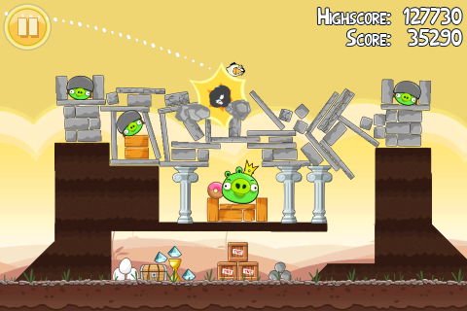
1 – Genres: to Each One‘s Taste
Casual Games

Slide 7
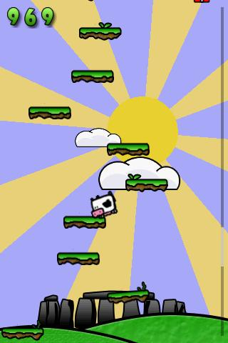
1 – Genres: to Each One‘s Taste
Casual Games

Slide 8
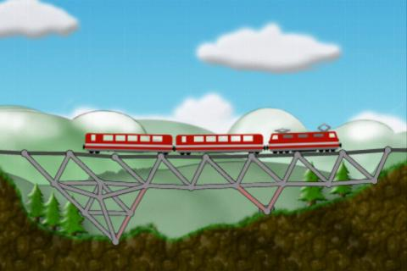
1 – Genres: to Each One‘s Taste
Puzzle Games

Slide 9
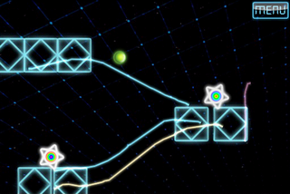
1 – Genres: to Each One‘s Taste
Puzzle Games

Slide 10
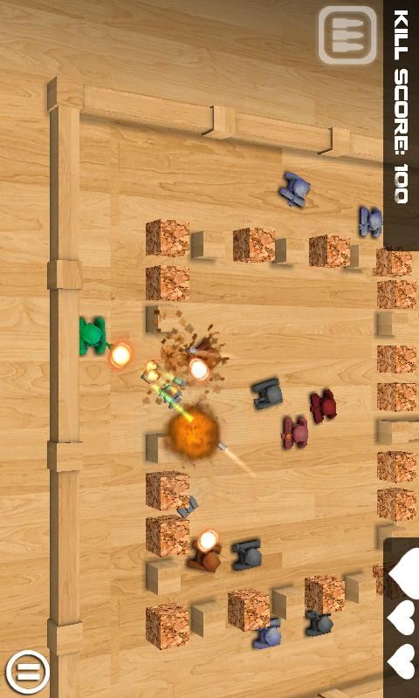
1 – Genres: to Each One‘s Taste
Arcade & Action Games

Slide 11
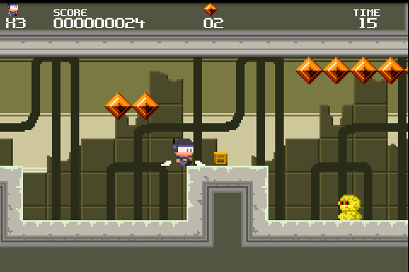
1 – Genres: to Each One‘s Taste
Arcade & Action Games

Slide 12
1 – Hardware
ARM CPU (500Mhz to 1Ghz dual cores).
Plenty of RAM (128MB to 1GB).
Only 20-25MB per application though.
Internal storage (256MB to 8GB).
External storage (Usually a couple GB).
Capacitive Touch Screen.
System Keys (Home, Back, Menu, Search)
Not all devices have all four keys! WTF?
Accelerometer.

Slide 13
1 – Hardware
Fragmentation Much?
Screen resolutions and sizes.
320x240, 480x320, 800x480, 854x480, …
3.2“, 4.1“, 4.3“…
Audio Latencies.
Samsung Galaxy S, Y U HAVE SO HIGH LATENCY?
Shoddy OpenGL ES drivers.
„Qualcooooooomm“ (in Captain Kirk voice).
Not relevant for this workshop.
Keyboards, Trackballs etc.
Some have them, some don‘t.
Looks worse than it really is.

Slide 14
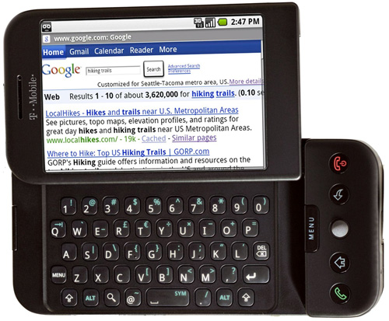
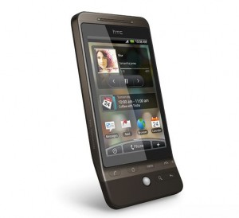
1 - Hardware
First Generation
HVGA (320x480)
Qualcomm CPU/GPU
MSM720xA
No true multi-touch
Comes with Android 1.5/1.6
Upgradable to 2.1
If you see one of those, RUN!

Slide 15
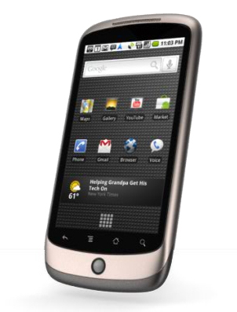
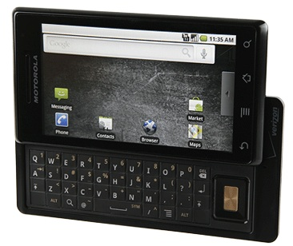
1 - Hardware
Second Generation
QVGA, HVGA, WVGA.
320x240, 480x320, 800x480
Diverse CPU/GPU.
Qualcomm Snapdragon
PowerVR SGX 530/535
Still no true multi-touch for some.
Android 2.1, 2.2.
Bigger, Better, Faster.

Slide 16
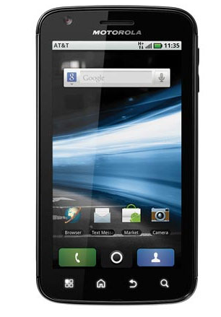
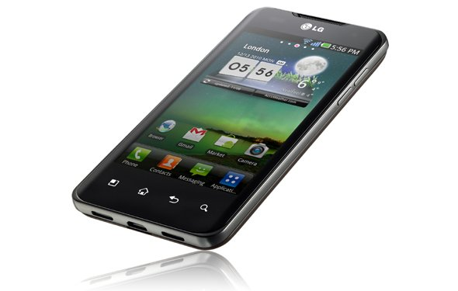
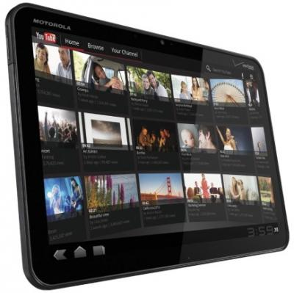
1 - Hardware
Next Generation
Dual Core CPUs
Nvidia Tegra GPUs (Yay!)
Finally proper multi-touch.
New form factors.
Tablets, e.g. Xoom, Toshiba Pad.
Android 2.2, 2.3, 3.0
Holy S%&$t that‘s fast!

Slide 17
1 - Software
Android 1.5/1.6
Low-End API, no multi-touch.
Dalvik stop-the-world GC pauses, no JIT.
Android 2.1
Multi-touch API. (But broken touch screens make kitty sad)
Dalvik improvements, GC still s%&$t, no JIT either.
Android 2.2
Finally JIT!
Slightly better GC
Android 2.3
Concurrent GC, pauses less intrusive.
Android 3.0
Renderscript, not that important for game devs.

Slide 18
Agenda
Android – A Gaming Platform
Game Design 101
Game Programming 101
Android for Game Developers
Lunch Break (Ohm Nom Nom Nom)
Droidanoid

Slide 19
2 – Plan Of Attack
What‘s a game made of?
Core Game Mechanics.
Story & Art Style.
Screens and Transitions.
Note: We do not write any code at this point! It‘s all about design. The code will emerge from the design naturally.

Slide 20
2 – Core Game Mechanics
What objects are there in our world?
How do they behave?
How do they interact?
How does the player interact with the game world?
Let‘s look at an old classic: Snake.

Slide 21
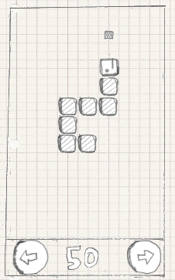
2 – Core Game Mechanics
The world is split up into a grid of cells.
The snake is composed of cell sized parts (one head and a number of tail parts).
The snake advances in the direction its head is pointed .
The snake can only advance from cell to cell.
If the snake goes outside the world boundaries, it reenters on the opposite side.
If the right or left button is pressed, the snake takes a 90 degree clock-wise (right) or counter-clockwise (left) turn.
If the snake hits a piece with its head, the piece disappears, the score is increased by 10 points, and a new piece appears on the playing field in a location that is not occupied by the snake itself. The snake also grows by one tail part. That new tail part is attached to the end of the snake.
If the snake hits itself (e.g., a part of its tail), the game is over.

Slide 22
2 – Core Game Mechanics
The world is split up into a grid of cells.
The snake is composed of cell sized parts (one head and a number of tail parts).
The snake advances in the direction its head is pointed .
The snake can only advance from cell to cell.
If the snake goes outside the world boundaries, it reenters on the opposite side.
If the right or left button is pressed, the snake takes a 90 degree clock-wise (right) or counter-clockwise (left) turn.
If the snake hits a piece with its head, the piece disappears, the score is increased by 10 points, and a new piece appears on the playing field in a location that is not occupied by the snake itself. The snake also grows by one tail part. That new tail part is attached to the end of the snake.
If the snake hits itself (e.g., a part of its tail), the game is over.
Holy S&%$t! Snake is complex!

Slide 23
2 – Story & Art Style
A simple story
“Enter the world of Mr. Nom. Mr. Nom is a paper snake, always eager to eat drops of ink that fall down from an unspecified source on his paper land. Mr. Nom is utterly selfish and has only a single, not so noble goal: becoming the biggest ink filled paper snake in the world!”

Slide 24

2 – Story & Art Style
The art style could be derrived from the story
We chose a „doodle“ graphics style
Easy to create, just use a pen, some paper and a scanner
The audio has to fit the graphics style
Some silly sound effects when a stain is eaten.
Funny Music is neat as well.

Slide 25
2 – Screens & Transitions
A game is more than just its mechanics
We have different screens
Main menu, highscore screen, game screen, etc.
Different events in a screen trigger a transition to another screen.
We can also have screens within screens!
Mind blown

Slide 26
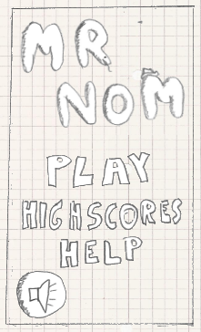
2 – Screens & Transitions
Main Menu Screen
Displays logo, menu items.
Clicking on a menu item triggers a transition to another screen.
The icon in the bottom is used to enable/disable audio.
The audio configuration needs to be saved for the next session.

Slide 27
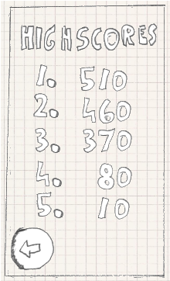
2 – Screens & Transitions
Highscore Screen
Displays highscores.
Highscores need to be loaded from somewhere.
The button in the bottom will trigger a transition to the main menu screen.

Slide 28
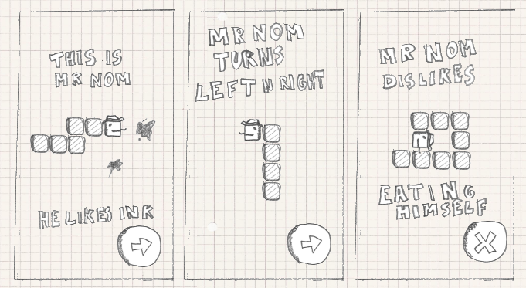
2 – Screens & Transitions
Help Screens
Display images, illustrating game mechanics.
Buttons to transition to the next screen.

Slide 29
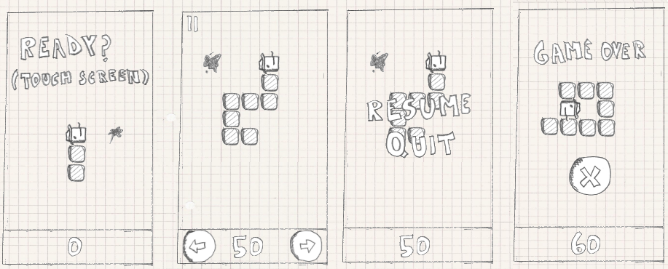
2 – Screens & Transitions
Game Screen
Displays and runs the core game
Has states: Ready, Running, Paused, Game Over

Slide 30
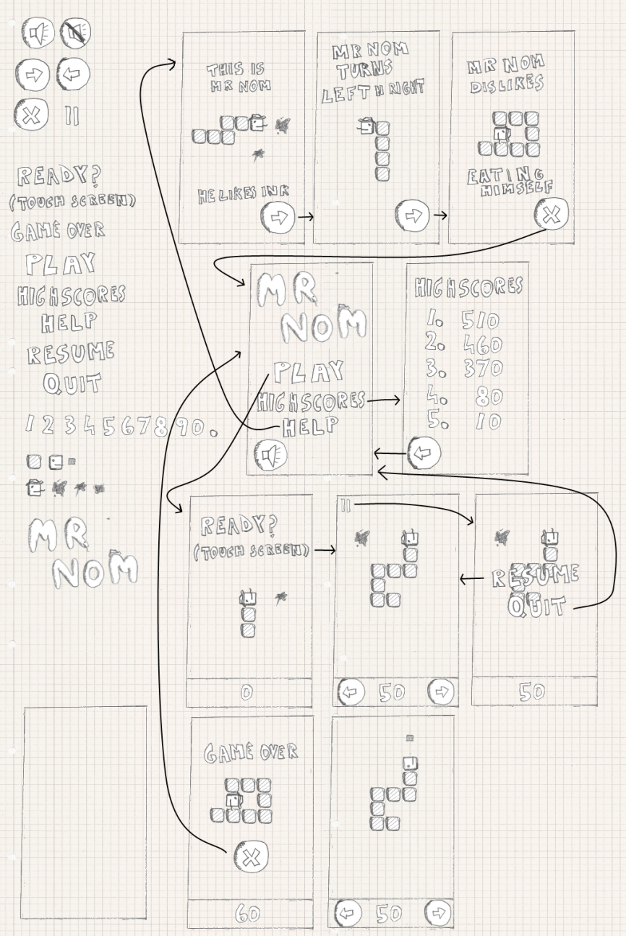
2 – Screens & Transitions

Slide 31
Agenda
Android – A Gaming Platform
Game Design 101
Game Programming 101
Android for Game Developers
Lunch Break (Ohm Nom Nom Nom)
Droidanoid

Slide 32
3 – Game Programming 101
Design tells us what we need code-wise.
Low-Level
Application Managment (Activity, Life-Cycle).
Loading and rendering graphics and audio.
Getting user input.
Persisting state (highscores).
High-Level
Implementing the screens/UI.
Code that simulates our game world.

Slide 33
3 – What‘s Application Managment?
Activity on Android, Window on the desktop.
Has to obey platform conventions.
Life-Cycle!
Game has to react to pause/resume gracefully.
Player can receive a call at any time and wants to pick up where she left.
Responsible for running the actual game.
Main loop ahead!

Slide 34
3 – What‘s a Main Loop?
Our game is a big old endless loop.
In each iteration we…
Update the current game screen based on user input.
Draw the game screen‘s graphics.
Playback the game screen‘s audio.
We want to do this as often as possible!
Low input latency.
Smooth Animations.
One such iteration is called a frame.
We want high framerates (frames per second)

Slide 35
3 – What‘s a Main Loop?
while(!gameOver) {
InputState inputState = readInput();
screen.update(inputState);
screen.render();
}

Slide 36
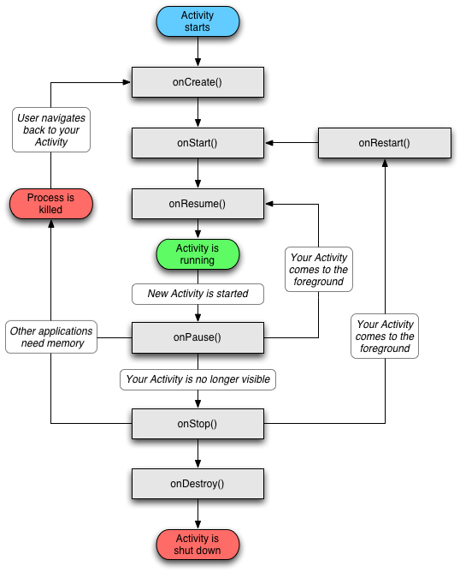

3 – What‘s a Main Loop?
Problem?
Where should we put our main loop?
Android Activities work on UI thread, we only get callbacks for events!
Can‘t block the UI thread!

Slide 37

3 – What‘s a Main Loop?
Solution: we create our own main loop thread!
UI Thread
Main Loop Thread
while(!gameOver && !activityDestroyed) {
if(!paused) {
InputState inputState = readInput();
screen.update(inputState);
screen.render();
}
}
Just need to inform ML thread of UI events

Slide 38
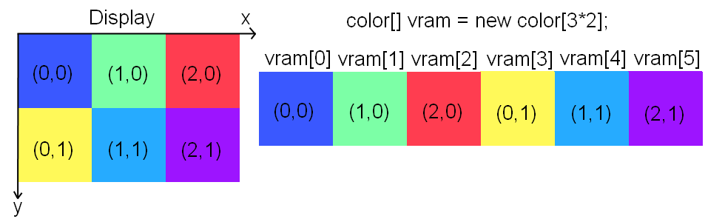
3 – 2D Graphics Programming
The display presents us the contents of something called the framebuffer.
The framebuffer is an area in (V)RAM
For each pixel on screen there‘s a corresponding memory cell in the framebuffer
Pixels are addressed with 2D coordinates.

Slide 39

3 – 2D Graphics Programming
To change what‘s displayed we change the colors of pixels in (V)RAM.
Pixel colors are encoded as RGB or RGBA
R -> red, G -> green, B -> blue, A -> alpha (transparency)
Different bit-depths / encodings
RGB565: 16-bit, 5 bits red, 6 bits green, 5 bits blue.
RGB888: 24-bit, 8 bits for each channel.
RGBA8888: 32-bit, 8 bits for each channel.

Slide 40
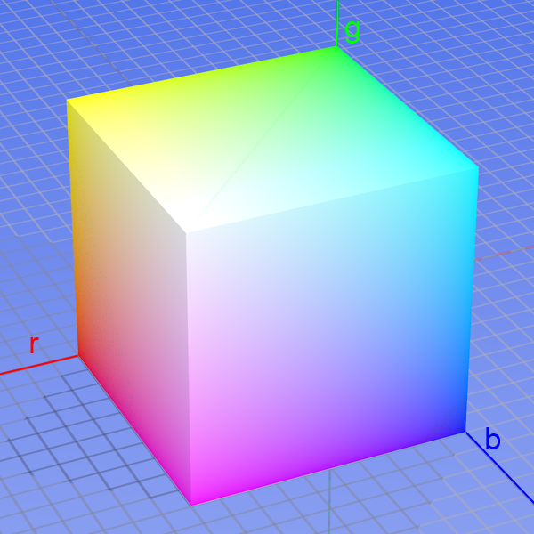
3 – 2D Graphics Programming
Behold the color cube!

Slide 41
3 – 2D Graphics Programming
To draw shapes we simply need to figure out which framebuffer pixels we have to set.
Images (==bitmaps) aren‘t special either!
Pixels of the bitmap get stored in a memory area, just like we store framebuffer pixels.
To draw a bitmap to the framebuffer we simply copy the pixels! (Blitting)
We can perform the same operations on bitmaps as we perform on the framebuffer, e.g. draw shapes or other bitmaps.

Slide 42
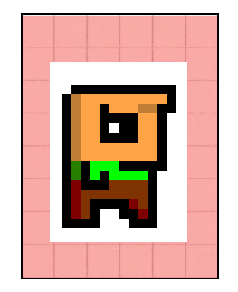
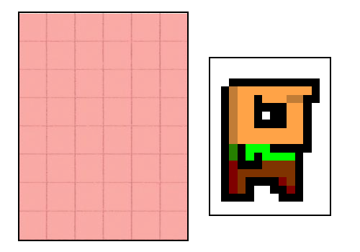
3 – 2D Graphics Programming
Blitting: copy (parts of) one bitmap to another.

Slide 43
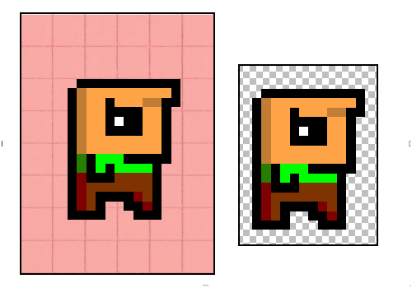
3 – 2D Graphics Programming
Alpha Compositing: blitting + alpha blending.
Alpha value of a pixel governs transparency
Instead of overwritting a destination pixel we mix its color with the source pixel.

Slide 44
3 – 2D Graphics Programming
Two Options:
SurfaceView & Canvas APIs.
OpenGL ES.
For many 2D games Canvas is enough.
Hardware accelerated on latest Android!
Orange Pixel games are poster children (Meganoid!)
OpenGL ES comes with its own problems:
Shoddy drivers.
Not a silver bullet for performance if you don‘t know what you do. Au Contraire!

Slide 45
3 – Audio Programming
Sound effects
Short audio snippets like explosions, shots.
Completely loaded into RAM.
Can be played back multiple times, simultaniously.
Music
Streamed on demand from the disk.
Too big to fit into RAM.
MP3 file of 3MB takes ~30MB decoded in RAM.

Slide 46
Input Processing
Polling
Read the current state of the input devices.
Current touch points and positions.
Currently pressed keys.
Accelerometer status.
No chronology.
Events
Callback when an input event happened (key down, etc.)
Chronological.

Slide 47
3 – Persisting State & File I/O
Reading/Writing Files
Other means of state persistency
Database
Not exactly rocket surgery.

Slide 48
3 – Game & Screens
We should wrap all low-level stuff.
A nice Game class would do!
It would be responsible for:
Managing the UI and main loop thread.
Keeping track of, update & render the current screen.
Allowing to transition from one screen to the next.
Passing on application events to the current screen.
Providing access to input events.
Loading and drawing bitmaps/playing sound & music
Let‘s devise a simple interface for that!

Slide 49
3 – The Game Class
public class Game extends Activity {
public abstract Screen createStartScreen();
public void setScreen(Screen screen) { }
public Bitmap loadBitmap(String fileName) { return null; }
public Music loadMusic(String fileName) { return null; }
public Sound loadSound(String fileName) { return null; }
public void clearFramebuffer(int color) { }
public void getFramebufferWidth() { return 0; }
public void getFramebufferHeight() { return 0; }
public void drawBitmap(Bitmap bitmap, int x, int y) { }
public void drawBitmap(Bitmap bitmap, int x, int y,
int srcX, int srcY,
int srcWidth, int srcHeight) { }
public boolean isKeyPressed(int keyCode) { return false; }
public boolean isTouchDown(int pointer) { return false; }
public int getTouchX(int pointer) { return 0; }
public int getTouchY(int pointer) { return 0; }
public List<com.badlogic.agd.KeyEvent> getKeyEvents() { return null; }
public List<com.badlogic.agd.KeyEvent> getKeyEvents() { return null; }
public float[] getAccelerometer();
}

Slide 50
3 – The Game Class
It‘s an Activity!
It sets up the main loop thread and updates the current screen there.
Screen transitions are triggered via Game.setScreen().
The current screen can use its methods to:
Load assets.
Render bitmaps and playback audio.
Get user input.
The createStartScreen() method must be implemented for each new game. It‘s the main entry point and returns the first screen!

Slide 51
3 – The Screen Class
A screen implements one phase of our game.
See design!
It will be managed by the Game instance and updated as often as possible on the main loop thread.
It‘s responsible for:
Updating the state, drawing and playing back audio.
Triggering transitions by calling Game.setScreen().
Game reports life-cycle events to it.

Slide 52
3 – The Screen Class
public abstract class Screen {
protected final Game game;
public Screen(Game game) {
this.game = game;
}
public abstract void update(float deltaTime);
public abstract void pause();
public abstract void resume();
public abstract void dispose();
}

Slide 53
3 – The Screen Class
We store a Game instance reference.
The update() method gets called as often as possible.
The pause()/resume() methods get called based on life-cycle events.
The dispose() method gets called when the app quits or a screen transition happens.
All this methods are called on the main loop thread!
Ignore the delta time parameter for now!

Slide 54
3 – A Simple Example
public class SimpleGame extends Game {
public Screen createStartScreen() {
return new SimpleScreen(this);
}
}
class SimpleScreen extends Screen {
int x = 0, y = 0;
Bitmap bitmap;
public SimpleScreen(Game game) {
super(game);
bitmap = game.loadBitmap("bitmap.png");
}
public void update(float deltaTime) {
if(game.isTouchDown(0)) {
x = game.getTouchX(0);
y = game.getTouchY(0);
}
game.clearFramebuffer(Color.BLACK);
game.drawBitmap(bitmap, x, y);
}
public void pause() { }
public void resume() { }
public void dispose() { }
}
On startup createStartScreen() is called, returning the Screen the Game should handle.
Next the SimpleScreen.update() method is called by the SimpleGame on the main loop thread.

Slide 55
3 – Run Through
The SimpleGame instance is created and will setup the main loop thread.
It then calls createStartScreen() and will update the returned Screen on the main loop thread as often as possible.
If the application is paused the Screen is informed and the main loop thread is paused.
If the application is resumed the Screen is informed and the main loop thread will continue updating the Screen again.
If the application is quit the Screen is informed and the main loop thread is destroyed.

Slide 56
3 – Code!
Let‘s implement all these classes for Android!

Slide 57
Agenda
Android – A Gaming Platform
Game Design 101
Game Programming 101
Android for Game Developers
Lunch Break (Ohm Nom Nom Nom)
Droidanoid

Slide 58
4 – Demystifying the Manifest File
The AndroidManifest.xml file governs how the Market filters our app.
It also specifies the permissions we need.
Additionally it lets Android know which Activities there are in our application.
Here are 10 easy steps to create a Android game project in Eclipse.

Slide 59
4 – Demystifying the Manifest File
Create a new Android project in Eclipse by opening the New Android Project dialog
Specify your project’s name and set the build target to the latest available SDK version.
Specify the name of your game, the package all your classes will be stored in, and the name of your main activity.
Set the minimum SDK version to 3.
Add the installLocation attribute to the <manifest> element in your manifest file and set it to “preferExternal”.
Add the debuggable attribute to the <application> element and set it to “true”.
Add the screenOrientation attribute to the <activity> element and specify the orientation you want (“portrait” or “landscape”).
Set the configChanges attribute of the <activity> element to “keyboard|keyboardHidden|orientation”.
Add two <uses-permission> elements to the <manifest> element and specify the name attributes “android.permission.WRITE_EXTERNAL_STORAGE” and “android.permission.WAKE_LOCK”.
Add the targetSdkVersion attribute to the <uses-sdk> element and specify your target SDK.

Slide 60
4 – Demystifying the Manifest File
<?xml version="1.0" encoding="utf-8"?>
<manifest xmlns:android="http://schemas.android.com/apk/res/android"
package="com.badlogic.agd"
android:versionCode="1"
android:versionName="1.0"
android:installLocation="preferExternal">
<application android:icon="@drawable/icon"
android:label="@string/app_name"
android:debuggable="true">
<activity android:name=".MyAwesomeGame"
android:label="@string/app_name"
android:configChanges="keyboard|keyboardHidden|orientation"
android:screenOrientation="landscape">
<intent-filter>
<action android:name="android.intent.action.MAIN" />
<category android:name="android.intent.category.LAUNCHER" />
</intent-filter>
</activity>
</application>
<uses-permission android:name="android.permission.WRITE_EXTERNALSTORAGE"/>
<uses-permission android:name="android.permission.WAKE_LOCK"/>
<uses-sdk android:minSdkVersion="3" android:targetSdkVersion="11"/>
</manifest>

Slide 61
4 – Plan of Attack
We‘ll now implement the classes we just discussed.
We‘ll implement the features iteratively, one step at a time.
For each feature we implement we have an example that derives from Game.
We declare each example as a startable Activity in the manifest file so we can test it.

Slide 62
4 – Wake Locks
The screen has a time-out after which it gets dimmed.
A no-go for most games.
We can fix this by using a wake lock.
Remember: we have to add a permission to the manifest file!

Slide 63
4 – Wake Locks
public abstract class Game extends Activity {
private WakeLock wakeLock;
public void onCreate(Bundle instanceBundle) {
super.onCreate(instanceBundle);
PowerManager powerManager = (PowerManager) getSystemService(Context.POWER_SERVICE);
wakeLock = powerManager.newWakeLock(PowerManager.FULL_WAKE_LOCK, "Game");
}
public void onPause() {
super.onPause();
wakeLock.release();
}
public void onResume() {
super.onResume();
wakeLock.acquire();
}
...

Slide 64
4 – Wake Locks
Create a new class called WakeLockExample.
Derrive it from Game.
Implement the createStartScreen() method by returning null.
Add the Activity to the manifest file and run it.
<activity android:name=".examples.WakeLockExample"
android:label="Wake Lock Example"
android:configChanges="keyboard|keyboardHidden|orientation"
android:screenOrientation="portrait">
<intent-filter>
<action android:name="android.intent.action.MAIN" />
</intent-filter>
</activity>

Slide 65
4 – Going Fullscreen
That title bar and the info bar take away precious screen space.
Let‘s get rid of these by going fullscreen!

Slide 66
4 – Going Fullscreen
public abstract class Game extends Activity {
...
public void onCreate(Bundle instanceBundle) {
...
requestWindowFeature(Window.FEATURE_NO_TITLE);
getWindow().setFlags(WindowManager.LayoutParams.FLAG_FULLSCREEN,
WindowManager.LayoutParams.FLAG_FULLSCREEN);
}
...
Create a new example called FullscreenExample analogous to WakeLockExample.
Run it!

Slide 67
4 – Adding the Main Loop Thread
Time to add the main loop thread.
It will be part of our Game instance.
It can be notified of the following states:
Running
Paused
Resumed
Disposed
We‘ll use the Java Thread class which executes a Runnable.
The Game will implement the Runnable interface and thus the main loop.

Slide 68
4 – Adding the Main Loop Thread
The life-cycle events will be reported on the UI thread via calls to onPause() and onResume().
We have to pipe those events to the main loop thread so it can react to them, e.g. inform the current Screen.
We create an enum called State encoding the four states.
We have an ArrayList<State> we put all state changes from the UI thread into.
The main loop thread reads that list in each iteration and reacts to the change.

Slide 69
4 – Adding the Main Loop Thread
public abstract class Game extends Activity implements Runnable {
...
private Thread mainLoopThread;
private State state = State.Paused;
private List<State> stateChanges = new ArrayList<State>();
...
public void run() {
while(true) {
synchronized (stateChanges) {
for(int i = 0; i < stateChanges.size(); i++) {
state = stateChanges.get(i);
if(state == State.Disposed) { Log.d("Game", “disposed"); return; }
if(state == State.Paused) { Log.d("Game", "paused"); return; }
if(state == State.Resumed) { state = State.Running; Log.d("Game", "resumed");
}
stateChanges.clear();
}
}
}
...
public enum State {
Running,
Paused,
Resumed,
Disposed
}

Slide 70
4 – Adding the Main Loop Thread
public abstract class Game extends Activity implements Runnable {
...
public void onResume() {
super.onResume();
wakeLock.acquire();
mainLoopThread = new Thread(this);
mainLoopThread.start();
synchronized (stateChanges) {
stateChanges.add(stateChanges.size(), State.Resumed);
}
}
public void onPause() {
super.onPause();
wakeLock.release();
synchronized (stateChanges) {
if(isFinishing()) {
stateChanges.add(stateChanges.size(), State.Disposed);
} else {
stateChanges.add(stateChanges.size(), State.Paused);
}
}
try { mainLoopThread.join(); } catch(InterruptedException e) { };
}
...

Slide 71
4 – Adding the Main Loop Thread
OMG, THREADING!
We create the main loop thread each time Game.onResume() is called and sent a State.Resume event to the thread.
We send a State.Dispose or State.Pause message in Game.onPaused() to thread which will quit the thread.
There is no main loop thread while our application is running!

Slide 72
4 – Adding a SurfaceView
We need a View to render to.
For this purpose we can use the SurfaceView class.
It‘s specifically tailored for our task (rendering in a separate thread).
We create a SurfaceView and set it as the content view of our Game Activity.
We get a SurfaceHolder from the SurfaceView.
With the SurfaceHolder we first check if the surface is valid, then lock it, render to the surface and unlock it which makes the changes to our surface visible.

Slide 73
4 – Adding a SurfaceView
public abstract class Game extends Activity implements Runnable {
...
private SurfaceView surfaceView;
private SurfaceHolder surfaceHolder;
public void onCreate(Bundle instanceBundle) {
surfaceView = new SurfaceView(this);
setContentView(surfaceView);
surfaceHolder = surfaceView.getHolder();
}
public void run() {
while(true) {
…
if(state == State.Running) {
if(!surfaceHolder.getSurface().isValid()) continue;
Canvas canvas = surfaceHolder.lockCanvas();
// all drawing happens here! E.g.
canvas.drawColor(Color.RED);
surfaceHolder.unlockCanvasAndPost(canvas);
}
}
}
...

Slide 74
4 – Adding Screen Managment
We need to manage the current Screen in our main loop thread.
Easy, we just need to call its respective methods where appropriate.
Screen.pause()/Screen.resume()/Screen.dispose() when we receive a life-cycle event in the stateChanges list.
Screen.update() in between the SurfaceHolder.lockCanvas()/Surfaceholder.unlockCanvasAndPost() calls.

Slide 75
4 – Adding Screen Managment
public abstract class Game extends Activity implements Runnable {
...
private Screen screen;
public void onCreate(Bundle instanceBundle) {
...
screen = createStartScreen();
}
public void run() {
while(true) {
synchronized (stateChanges) {
for(int i = 0; i < stateChanges.size(); i++) {
if(state == State.Disposed) { if(screen != null) screen.dispose(); ... }
if(state == State.Paused) { if(screen != null) screen.pause(); ... }
if(state == State.Resumed) { if(screen != null) screen.resume(); ... }
}
stateChanges.clear();
}
if(state == State.Running) {
if(!surfaceHolder.getSurface().isValid()) continue;
Canvas canvas = surfaceHolder.lockCanvas();
if(screen != null) screen.update(0);
surfaceHolder.unlockCanvasAndPost(canvas);
}
}
}

Slide 76
4 – Adding Screen Managment
public abstract class Game extends Activity implements Runnable {
...
public void setScreen(Screen screen) {
if(this.screen != null) screen.dispose();
this.screen = screen;
}
...
}
public class ScreenManagmentExample extends Game {
public Screen createStartScreen() {
return new TestScreen(this);
}
class TestScreen extends Screen {
public TestScreen(Game game) {
super(game);
}
public void update(float deltaTime) { }
public void pause() { Log.d("TestScreen", "pause"); }
public void resume() { Log.d("TestScreen", "resume"); }
public void dispose() { Log.d("TestScreen", "dispose"); }
}
}

Slide 77
4 – Application Managment Complete!
We are done with our application managment:
Setting up the main loop thread and a render surface.
Handling life-cycle events.
Managing screens.
One tiny little bit is missing: the delta time
We‘ll add that later on once we understand why we need it!
On to the graphics methods of Game.

Slide 78
4 – Implementing the Graphics Methods.
Game has methods for:
Clearing the framebuffer (our SurfaceView!).
Getting the framebuffer dimensions.
Loading & drawing Bitmaps.
Let‘s start with the first two, clearing the screen and getting the framebuffer dimensions.

Slide 79
4 – Implementing the Graphics Methods.
In Game.run() we get a Canvas instance.
Canvas is a class provided by the Android API that let‘s us draw to a Bitmap or Surface(View).
It has a ton of methods to draw shapes, bitmaps and so on.
The drawing methods of Game will use this Canvas to execute.
The method to clear the target of the Canvas is Canvas.drawColor(int color).
The color argument is a 32-bit ARGB color.

Slide 80
4 – Implementing the Graphics Methods
public abstract class Game extends Activity implements Runnable {
...
private Canvas canvas = null;
...
public void run() {
while(true) {
...
if(state == State.Running) {
if(!surfaceHolder.getSurface().isValid()) continue;
canvas = surfaceHolder.lockCanvas(); // we store the Canvas in the member now!
if(screen != null) screen.update(0);
surfaceHolder.unlockCanvasAndPost(canvas);
canvas = null;
}
}
}
public void clearFrameBuffer(int color) {
if(canvas != null) canvas.drawColor(color);
}
public void getFramebufferWidth() { return surfaceView.getWidth(); }
public void getFramebufferHeight() { return surfaceView.getHeight(); }
...
}

Slide 81
4 – Implementing the Graphics Methods
public class ClearExample extends Game {
public Screen createStartScreen() {
return new ClearScreen(this);
}
class ClearScreen extends Screen {
Random rand = new Random();
public ClearScreen(Game game) {
super(game);
}
public void update(float deltaTime) {
game.clearFramebuffer(rand.nextInt());
}
public void pause() { }
public void resume() { }
public void dispose() { }
}
}

Slide 82
4 – Implementing the Graphics Methods
Next we want to implement the Bitmap loading method.
We will store all our images in the assets/ folder.
Android messes with images that are stored in the res/drawable-XXX folders, we want more control.
We‘ll use the BitmapFactory to load images.

Slide 83
4 – Implementing the Graphics Methods
public abstract class Game extends Activity implements Runnable {
...
public Bitmap loadBitmap(String fileName) {
InputStream in = null;
Bitmap bitmap = null;
try {
in = getAssets().open(fileName);
bitmap = BitmapFactory.decodeStream(in);
if (bitmap == null)
throw new RuntimeException("Couldn't load bitmap from asset '"
+ fileName + "'");
return bitmap;
} catch (IOException e) {
throw new RuntimeException("Couldn't load bitmap from asset '"
+ fileName + "'");
} finally {
if (in != null) try { in.close(); } catch (IOException e) { }
}
}
...
}

Slide 84
4 – Implementing the Graphics Methods
Drawing Bitmaps is just as easy as loading.
We just need to invoke one of the methods of the Canvas class.
The method is called Canvas.drawBitmap() and comes in two flavors:
One for blitting the complete source Bitmap to the target.
One for blitting parts of the source Bitmap to the target, potentially stretched.

Slide 85
4 – Implementing the Graphics Methods
public abstract class Game extends Activity implements Runnable {
...
public void drawBitmap(Bitmap bitmap, int x, int y) {
if(canvas != null) canvas.drawBitmap(bitmap, x, y, null);
}
Rect src = new Rect();
Rect dst = new Rect();
public void drawBitmap(Bitmap bitmap, int x, int y, int srcX, int srcY,
int srcWidth, int srcHeight) {
if(canvas == null) return;
src.left= srcX;
src.top = srcY;
src.right = srcX + srcWidth;
src.bottom = srcY + srcHeight;
dst.left = x;
dst.top = y;
dst.right = x + srcWidth;
dst.bottom = y + srcHeight;
canvas.drawBitmap(bitmap, src, dst, null);
} ...
}

Slide 86
4 – Implementing the Graphics Methods
public class BitmapExample extends Game {
public Screen createStartScreen() {
return new BitmapScreen(this);
}
class BitmapScreen extends Screen {
Bitmap bob;
public BitmapScreen(Game game) {
super(game);
bob = game.loadBitmap("bob.png");
}
public void update(float deltaTime) {
game.clearFrameBuffer(Color.BLUE);
game.drawBitmap(bob, 10, 10);
game.drawBitmap(bob, 100, 128, 0, 0, 64, 64);
}
public void pause() { }
public void resume() { }
public void dispose() { }
}
}

Slide 87
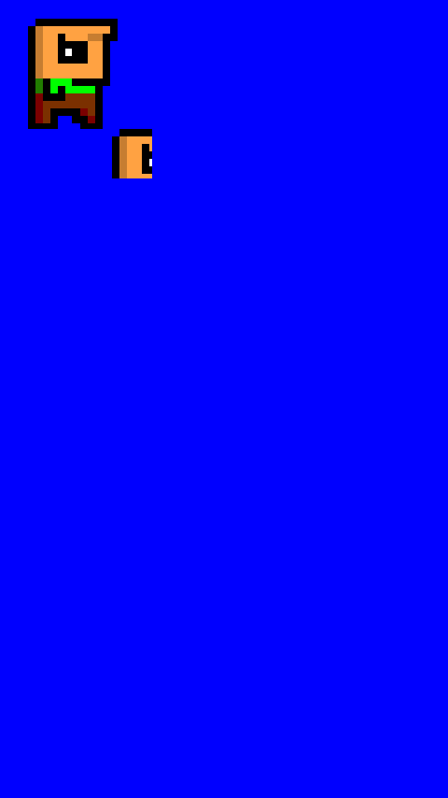
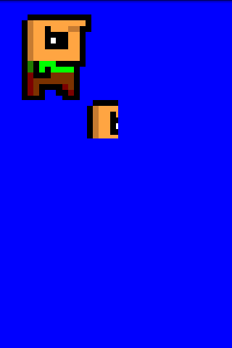
4 – Different Screen Resolutions
Ouch!
320x480
480x854

Slide 88
4 – Different Screen Resolutions
We want all players to see the same.
Problem:
Different aspect ratios (width / height).
Different screen resolutions.
Simple solution:
Assume a target resolution, e.g. 320x480.
Create a temporary bitmap of that size.
Direct all drawing to that bitmap.
At the end of a frame blit the bitmap to the real framebuffer, stretching it if necessary.
Copes with different screen resolutions, produces some stretching due to difference in aspect ratio.
We work in a unified coordinate system, no matter the actual screen resolution!
Good enough for most games!

Slide 89
4 – Implementing the Graphics Methods
public abstract class Game extends Activity implements Runnable {
...
private Bitmap offscreenSurface;
public void onCreate(Bundle instanceBundle) {
...
if(surfaceView.getWidth() > surfaceView.getHeight()) {
setOffscreenSurface(480, 320);
} else {
setOffscreenSurface(320, 480);
}
}
public void setOffscreenSurface(int width, int height) {
if(offscreenSurface != null) offscreenSurface.recycle();
offscreenSurface = Bitmap.createBitmap(width, height, Config.RGB_565);
canvas = new Canvas(offscreenSurface);
}
public int getFramebufferWidth() {
return offscreenSurface.getWidth();
}
public int getFramebufferHeight() {
return offscreenSurface.getHeight();
}
...
}

Slide 90
4 – Implementing the Graphics Methods
public abstract class Game extends Activity implements Runnable {
...
public void run() {
while(true) {
...
if(state == State.Running) {
if(!surfaceHolder.getSurface().isValid()) continue;
Canvas canvas = surfaceHolder.lockCanvas();
if(screen != null) screen.update(0);
src.left = 0;
src.top = 0;
src.right = offscreenSurface.getWidth() - 1;
src.bottom = offscreenSurface.getHeight() - 1;
dst.left = 0;
dst.top = 0;
dst.right = surfaceView.getWidth();
dst.bottom = surfaceView.getHeight();
canvas.drawBitmap(offscreenSurface, src, dst, null);
surfaceHolder.unlockCanvasAndPost(canvas);
}
}
}...
}

Slide 91

4 – Different Screen Resolutions
Not perfect but better!
320x480
480x854

Slide 92
4 – Different Screen Resolutions
We could also use a larger target resolution (e.g. 800x480) and scale down on lower resolution devices.
Just call Game.setOffscreenSurface() with whatever resolution you want to work with.
There‘s another solution to this but it has the downside of showing more/less of the game to a player depending on the aspect ratio.
For our purposes the offscreen method is more than sufficient.

Slide 93
4 – Implementing the Input Methods
We need to hook up listeners to the SurfaceView and SensorManager in order to get key and touch events as well as accelerometer readings.
We need to pipe those events to the main loop thread since our Screen.update() method is called there.
Polling is easy: we just store the status of the input devices in members of Game.
Event-based input is harder due to threading.

Slide 94
4 – Implementing the Input Methods
For touch events we register an OnTouchListener with the SurfaceView.
For key events we register a OnKeyListener with the SurfaceView.
For accelerometer readings we register a SensorEventListener with the SensorManager.
In our implementation of the methods of these interfaces we simply store the current states.
Let‘s begin with the (polled) key events.

Slide 95
4 – Implementing the Input Methods
public abstract class Game extends Activity implements Runnable, OnKeyListener {
...
private boolean pressedKeys[] = new boolean[256];
public void onCreate(Bundle instanceBundle) {
...
surfaceView.setFocusableInTouchMode(true);
surfaceView.requestFocus();
surfaceView.setOnKeyListener(this);
}
public boolean onKey(View v, int keyCode, KeyEvent event) {
if(event.getAction() == KeyEvent.ACTION_DOWN)
pressedKeys[keyCode] = true;
if(event.getAction() == KeyEvent.ACTION_UP)
pressedKeys[keyCode] = false;
return false;
}
public boolean isKeyPressed(int keyCode) {
return pressedKeys[keyCode];
}
...
}

Slide 96
4 – Implementing the Input Methods
public class PollingKeyExample extends Game {
public Screen createStartScreen() {
return new PollingKeyScreen(this);
}
class PollingKeyScreen extends Screen {
int clearColor = Color.BLUE;
public PollingKeyScreen(Game game) {
super(game);
}
public void update(float deltaTime) {
game.clearFramebuffer(clearColor);
if(game.isKeyPressed(KeyEvent.KEYCODE_MENU)) {
clearColor = (int)(Math.random() * Integer.MAX_VALUE);
}
}
public void pause() { }
public void resume() { }
public void dispose() { }
}
}

Slide 97
4 – Implementing the Input Methods
Touch Events are a bit of a problem:
No multi-touch API on Android 1.5/1.6
How can we support all Android versions?
We create a touch event handler for Android 1.5/1.6 that can only process single-touch events.
We create another touch event handler for Android > 1.6 that can also process multi-touch events.
We also need to adjust the raw touch coordinates for the offscreen surface dimensions so we work in the same coordinate system!

Slide 98
4 – Implementing the Input Methods
public interface TouchHandler {
public boolean isTouchDown(int pointer);
public int getTouchX(int pointer);
public int getTouchY(int pointer);
}
Implementations are to big for slides. See:
src/com/badlogic/agd/SingleTouchHandler.java
src/com/badlogic/agd/MultiTouchHandler.java

Slide 99
4 – Implementing the Input Methods
public abstract class Game extends Activity implements Runnable, OnKeyListener {
...
private TouchHandler touchHandler;
public void onCreate(Bundle instanceBundle) {
...
if(Integer.parseInt(VERSION.SDK) < 5)
touchHandler = new SingleTouchHandler(surfaceView);
else
touchHandler = new MultiTouchHandler(surfaceView);
}
public boolean isTouchDown(int pointer) {
return touchHandler.isTouchDown(pointer);
}
public int getTouchX(int pointer) {
return (int)(touchHandler.getTouchX(pointer) /
(float)surfaceView.getWidth() *
offscreenSurface.getWidth());
}
public int getTouchY(int pointer) {
return (int)(touchHandler.getTouchY(pointer) /
(float)surfaceView.getHeight() *
offscreenSurface.getHeight());
}...
}

Slide 100
4 – Implementing the Input Methods
public class TouchExample extends Game {
public Screen createStartScreen() {
return new TouchScreen(this);
}
class TouchScreen extends Screen {
Bitmap bob;
public TouchScreen(Game game) {
super(game);
bob = game.loadBitmap("bob.png");
}
public void update(float deltaTime) {
game.clearFramebuffer(Color.BLUE);
for(int pointer = 0; pointer < 5; pointer++) {
if(game.isTouchDown(pointer)) {
game.drawBitmap(bob, game.getTouchX(pointer), game.getTouchY(pointer));
}
}
}
public void pause() { }
public void resume() { }
public void dispose() { }
}
}

Slide 101
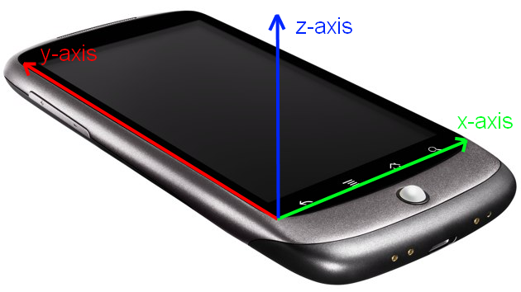
4 – Implementing the Input Methods
The accelerometer gives us the acceleration in meters per second on 3 axes.
They range from -10 to 10 (acceleration the earth‘s gravity field excerts on a body)

Slide 102
4 – Implementing the Input Methods
public abstract class Game extends Activity implements Runnable, OnKeyListener,
SensorEventListener {
...
private float[] accelerometer = new float[3];
public void onCreate(Bundle instanceBundle) {
...
SensorManager manager = (SensorManager).getSystemService(Context.SENSOR_SERVICE);
if (manager.getSensorList(Sensor.TYPE_ACCELEROMETER).size() != 0) {
Sensor accelerometer = manager.getSensorList(Sensor.TYPE_ACCELEROMETER).get(0);
manager.registerListener(this, accelerometer, SensorManager.SENSOR_DELAY_GAME);
}
}
public float[] getAccelerometer() { return accelerometer; }
public void onAccuracyChanged(Sensor sensor, int accuracy) { }
public void onSensorChanged(SensorEvent event) {
System.arraycopy(event.values, 0, accelerometer, 0, 3);
}
public void onPause() {
...
if(isFinishing()) ((SensorManager)getSystemService(Context.SENSOR_SERVICE)).unregisterListener(this);
}
}

Slide 103
4 – Implementing the Input Methods
public class AccelerometerExample extends Game {
public Screen createStartScreen() {
return new AccelerometerScreen(this);
}
class AccelerometerScreen extends Screen {
Bitmap bob;
public AccelerometerScreen(Game game) {
super(game);
bob = game.loadBitmap("bob.png");
}
public void update(float deltaTime) {
float x = -game.getAccelerometer()[0];
float y = game.getAccelerometer()[1];
x = (x / 10) * game.getFramebufferWidth() / 2 + game.getFramebufferWidth() / 2;
y = (y / 10) * game.getFramebufferHeight() / 2 + game.getFramebufferHeight() / 2;
game.clearFramebuffer(Color.BLUE);
game.drawBitmap(bob, (int)x - 64, (int)y - 64);
}
public void pause() { }
public void resume() { }
public void dispose() { }
}
}

Slide 104
4 – Implementing the Input Methods
We have all input polling methods in place.
Event-based input makes sense for key events and the touch screen.
Problem: we need to pass on instances of KeyEvent and TouchEvent to our main loop thread from the UI thread.
We could do this with a list for each event type.
But we‘d create new events all the time!
That would make the GC angry.
Solution: Pooling KeyEvent/TouchEvent instances!

Slide 105
4 – Implementing the Input Methods
public abstract class Pool<T> {
private List<T> items = new ArrayList<T>();
protected abstract T newItem();
public T obtain() {
if(items.size() == 0) return newItem();
return items.remove(0);
}
public void free(T item) {
items.add(item);
}
}

Slide 106
4 – Implementing the Input Methods
Instead of calling new KeyEvent() we call Pool<KeyEvent>.obtain().
We need to implement the Pool.newItem() method of course.
Pool for TouchEvent instances analogous.
public class KeyEventPool extends Pool<KeyEvent> {
protected KeyEvent newItem() {
return new KeyEvent();
}
}

Slide 107
4 – Implementing the Input Methods
Our strategy for each event type:
We have a Pool to create and recycle event instances.
We have a buffer that gets filled with events on the UI thread.
We have a second buffer that we move the UI thread buffer contents to on the main loop thread.
The Game.getXXXEvents() methods return this second buffer to the current Screen.
Once the Screen is updated we can recycle all the events in the second buffer.
Goto 1 :)
Let‘s implement this for key events.

Slide 108
4 – Implementing the Input Methods
public abstract class Game extends Activity implements Runnable, OnKeyListener,
SensorEventListener {
...
private KeyEventPool keyEventPool = new KeyEventPool();
private List<com.badlogic.agd.KeyEvent> keyEvents = new ArrayList<com.badlogic.agd.KeyEvent>();
private List<com.badlogic.agd.KeyEvent> keyEventBuffer = new ArrayList<com.badlogic.agd.KeyEvent>();
private void fillEvents() {
synchronized (keyEventBuffer) {
for(int i = 0; i < keyEventBuffer.size(); i++) { keyEvents.add(keyEventBuffer.get(i)); }
keyEventBuffer.clear();
}
}
private void freeEvents() {
synchronized(keyEventBuffer) {
for(int i = 0; i < keyEvents.size(); i++) { keyEventPool.free(keyEvents.get(i));
keyEvents.clear();
}
}
}

Slide 109
4 – Implementing the Input Methods
public abstract class Game extends Activity implements Runnable, OnKeyListener,
SensorEventListener {
...
public boolean onKey(View v, int keyCode, KeyEvent event) {
if(event.getAction() == KeyEvent.ACTION_DOWN) {
pressedKeys[keyCode] = true;
synchronized(keyEventBuffer) {
com.badlogic.agd.KeyEvent keyEvent = keyEventPool.obtain();
keyEvent.type = KeyEventType.Down;
keyEvent.keyCode = keyCode;
keyEventBuffer.add(keyEvent);
}
}
if(event.getAction() == KeyEvent.ACTION_UP) {
pressedKeys[keyCode] = false;
synchronized(keyEventBuffer) {
com.badlogic.agd.KeyEvent keyEvent = keyEventPool.obtain();
keyEvent.type = KeyEventType.Up;
keyEvent.keyCode = keyCode;
keyEvent.character = (char)event.getUnicodeChar();
keyEventBuffer.add(keyEvent);
}
}
return false;
}
}

Slide 110
4 – Implementing the Input Methods
public abstract class Game extends Activity implements Runnable, OnKeyListener,
SensorEventListener {
...
public boolean onKey(View v, int keyCode, KeyEvent event) {
if(event.getAction() == KeyEvent.ACTION_DOWN) {
pressedKeys[keyCode] = true;
synchronized(keyEventBuffer) {
com.badlogic.agd.KeyEvent keyEvent = keyEventPool.obtain();
keyEvent.type = KeyEventType.Down;
keyEvent.keyCode = keyCode;
keyEventBuffer.add(keyEvent);
}
}
if(event.getAction() == KeyEvent.ACTION_UP) {
pressedKeys[keyCode] = false;
synchronized(keyEventBuffer) {
com.badlogic.agd.KeyEvent keyEvent = keyEventPool.obtain();
keyEvent.type = KeyEventType.Up;
keyEvent.keyCode = keyCode;
keyEvent.character = (char)event.getUnicodeChar();
keyEventBuffer.add(keyEvent);
}
}
return false;
}
}

Slide 111
4 – Implementing the Input Methods
public abstract class Game extends Activity implements Runnable, OnKeyListener,
SensorEventListener {
...
public void run() {
...
while(true) {
...
if(state == State.Running) {
...
fillEvents();
if(screen != null) screen.update(0);
freeEvents();
...
}
}
}

Slide 112
4 – Implementing the Input Methods
public class KeyEventExample extends Game {
public Screen createStartScreen() {
return new KeyEventScreen(this);
}
class KeyEventScreen extends Screen {
public KeyEventScreen(Game game) {
super(game);
}
public void update(float deltaTime) {
List<KeyEvent> keyEvents = game.getKeyEvents();
for(int i = 0; i < keyEvents.size(); i++) {
KeyEvent event = keyEvents.get(i);
Log.d("KeyEventScreen", "key: " +
event.type + ", " +
event.keyCode + ", " +
event.character);
}
}
public void pause() { }
public void resume() { }
public void dispose() { }
}
}

Slide 113
4 – Implementing the Input Methods
We do exactly the same for touch events!
The TouchEvent buffer is filled on the UI thread in the TouchHandler.
On the main loop thread we copy the events from the UI buffer to the main loop buffer and provide it to the Screen.
I spare you the detailed code.
Here‘s an example

Slide 114
4 – Implementing the Input Methods
public class TouchEventExample extends Game {
public Screen createStartScreen() {
return new TouchEventScreen(this);
}
class TouchEventScreen extends Screen {
public TouchEventScreen(Game game) {
super(game);
}
public void update(float deltaTime) {
List<TouchEvent> touchEvents = game.getTouchEvents();
for(int i = 0; i < touchEvents.size(); i++) {
TouchEvent event = touchEvents.get(i);
Log.d("TouchEventScreen", "key: " +
event.type + ", " +
event.x + ", " +
event.y + ", " +
event.pointer);
}
}
public void pause() { }
public void resume() { }
public void dispose() { }
}
}

Slide 115
4 – Implementing the Audio Methods
We have two methods to load Sound and Music instances from asset files.
For Sounds we use the SoundPool class of Android.
For Music we wrap the Android MediaPlayer class.
Sound and Music instances need to be disposed if they are no longer used to free up resources.
(The same is true for Bitmaps btw.)

Slide 116
4 – Implementing the Audio Methods
public abstract class Game extends Activity implements Runnable, OnKeyListener {
...
private SoundPool soundPool;
public void onCreate(Bundle instanceBundle) {
...
setVolumeControlStream(AudioManager.STREAM_MUSIC);
this.soundPool = new SoundPool(20, AudioManager.STREAM_MUSIC, 0);
}
public Sound loadSound(String fileName) {
try {
AssetFileDescriptor assetDescriptor = getAssets().openFd(fileName);
int soundId = soundPool.load(assetDescriptor, 0);
return new Sound(soundPool, soundId);
} catch (IOException e) {
throw new RuntimeException("Couldn't load sound '" + fileName + "'");
}
}
public void onPause() {
...
if(isFinishing()) soundPool.release();
}...
}

Slide 117
4 – Implementing the Audio Methods
public class SoundExample extends Game {
public Screen createStartScreen() {
return new SoundScreen(this);
}
class SoundScreen extends Screen {
Sound sound;
public SoundScreen(Game game) {
super(game);
sound = game.loadSound("explosion.ogg");
}
public void update(float deltaTime) {
if(game.isTouchDown(0)) sound.play(1);
}
public void pause() { }
public void resume() { }
public void dispose() { sound.dispose(); }
}
}

Slide 118
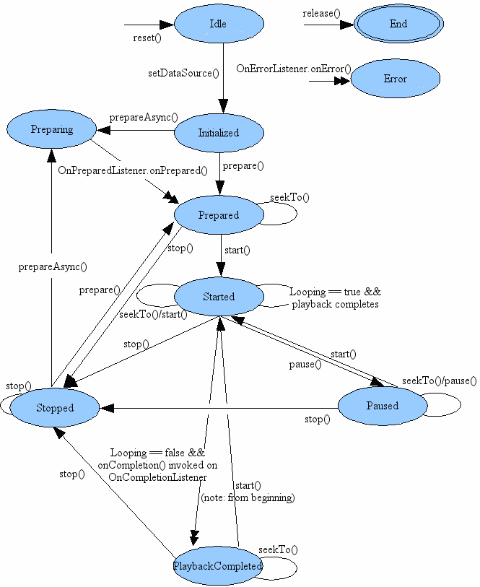
4 – Implementing the Audio Methods
For the Music class we use Android‘s MediaPlayer.
Why wrap it? That‘s why:

Slide 119
4 – Implementing the Audio Methods
public abstract class Game extends Activity implements Runnable, OnKeyListener {
...
public Music loadMusic(String fileName) {
try {
AssetFileDescriptor assetDescriptor = getAssets().openFd(fileName);
return new Music(assetDescriptor);
} catch (IOException e) {
throw new RuntimeException("Couldn't load music '" + fileName + "'");
}
}
...
}

Slide 120
4 – Implementing the Audio Methods
public class MusicExample extends Game {
public Screen createStartScreen() {
return new MusicScreen(this);
}
class MusicScreen extends Screen {
Music music;
boolean isPlaying = false;
public MusicScreen(Game game) {
super(game);
music = game.loadMusic("music.ogg");
music.setLooping(true); music.play();
isPlaying = true;
}
public void update(float deltaTime) {
if(game.isTouchDown(0)) {
if(music.isPlaying()) {
music.pause(); isPlaying = false;
}
else {
music.play(); isPlaying = true;
}
}
}
public void pause() { music.pause(); }
public void resume() { if(isPlaying) music.play(); }
public void dispose() { music.dispose(); }
}
}

Slide 121
4 – Implementing the Audio Methods
We need to make sure to pause/dispose the music when the application is paused/disposed.
Otherwise the MediaPlayer will happily continue to play.

Slide 122
4 - File I/O
We can access assets like this:
InputStream in = Game.getAssets().open("filename");
Assets are read only!

Slide 123
4 – File I/O
We can read & write files on the external storage.
The storage must be mounted:
Environment.getExternalStorageState().equals(Environment.MEDIA_MOUNTED);
Path to the external storage:
File dir = Environment.getExternalStorageDirectory();
From here on we can use standard Java I/O.

Slide 124
4 – File I/O
For small data items like highscores we can use Android‘s SharedPreferences.
It‘s basically a named HashMap you can put different primitive types in.
Creation:
Game.getSharedPreferences(„name“, 0);
Fetching values:
SharedPreferences.getXXX(String key, XXX default);
Writing values is a little more involved.

Slide 125
4 – File I/O
Need to get an Editor instance from the SharedPreferences:
Editor editor = preferences.edit();
Put values in the Editor:
editor.putString(„key“, „value“);
Commit the changes for future use:
editor.commit();
We can also clear everything or a single item:
editor.clear();
Editor.remove(„key“);

Slide 126
4 – Framerate & Delta Time
The framerate is the number of frames we render/update per second.
Let‘s add a new method to Game called Game.getFrameRate()
It will return the (average) number of frames.
We simply count how often the main loop iterates in a second.
We can use this method to see how well our game performs.

Slide 127
4 – Framerate & Delta Time
public abstract class Game extends Activity implements Runnable, OnKeyListener {
...
private int framesPerSecond = 0;
public void run() {
int frames = 0;
long startTime = System.nanoTime();
while(true) {
...
frames++;
if(System.nanoTime() – startTime > 1000000000) {
framesPerSecond = frames;
frames = 0;
startTime = System.nanoTime();
}
}
}
public int getFramerate() {
return framesPerSecond;
}
}

Slide 128
4 – Framerate & Delta Time
public class FramerateExample extends Game {
public Screen createStartScreen() {
return new FramerateScreen(this);
}
class FramerateScreen extends Screen {
public FramerateScreen(Game game) {
super(game);
}
public void update(float deltaTime) {
Log.d("FramerateScreen", "fps: " + game.getFramerate());
}
public void pause() { }
public void resume() { }
public void dispose() { }
}
}

Slide 129
4 – Framerate & Delta Time
Look at the code below.
What would happen on a device that can do 30 FPS?
What would happen on a device that can do 60 FPS?
public class MoverScreen extends Screen {
Bitmap bitmap;
float x = 0;
public void update(float deltaTime) {
x += 1;
game.drawBitmap(bitmap, x, 0);
}
}

Slide 130
4 – Framerate & Delta Time
The Image would move faster on the 60 FPS device!

Slide 131
4 – Framerate & Delta Time
Solution: Time-based Movement
A.k.a. Framerate-Independent Movement
Objects have
Position expressed as 2D coordinates (x,y)
Velocity expressed as 2D vector (vx,vy)
Unit can be meter/pixel/etc. for position.
Unit can be meter/pixel/etc. per second for velocity.
Update of position:
newx = oldx + vx * deltaTime;
newx = oldy + vy * deltaTime;

Slide 132
4 – Framerate & Delta Time
Delta time is the timespan passed since the last update.
We just need to keep track how much time has passed between the current frame and the last frame.
At 60 FPS we have a delta time of 1 / 60 ~ 0.016 seconds.
At 30 FPS we have a delta time of 1 / 30 ~ 0.032 seconds.

Slide 133
4 – Framerate & Delta Time
public abstract class Game extends Activity implements Runnable, OnKeyListener {
...
public void run() {
...
long lastTime = System.nanoTime();
while(true) {
...
long currTime = System.nanoTime();
if(screen != null) screen.update((currTime - lastTime) / 1000000000.0f);
lastTime = currTime;
...
}
}
public int getFramerate() {
return framesPerSecond;
}
}

Slide 134
4 – Framerate & Delta Time
public class DeltaTimeExample extends Game {
public Screen createStartScreen() {
return new DeltaTimeScreen(this);
}
class DeltaTimeScreen extends Screen {
Bitmap bob;
float x = 0;
public DeltaTimeScreen(Game game) {
super(game);
bob = game.loadBitmap("bob32.png");
}
public void update(float deltaTime) {
x = x + 10 * deltaTime;
game.clearFramebuffer(Color.BLUE);
game.drawBitmap(bob, (int)x, 10);
}
public void pause() { }
public void resume() { }
public void dispose() { }
}
}

Slide 135
Agenda
Android – A Gaming Platform
Game Design 101
Game Programming 101
Android for Game Developers
Lunch Break (Ohm Nom Nom Nom)
Droidanoid

Slide 136
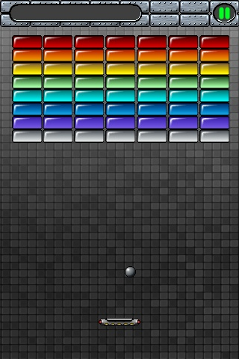
5 - Droidanoid
A Breakout Clone!

Slide 137
5 – Core Game Mechanics
Paddle on the bottom can move left/right based on accelerometer.
Ball has a direction in which it moves.
Ball bounces of walls, left, right and top.
If ball hits a block, the block is destroyed and the ball changes direction
Player is awarded points based on color of block (10, 15, 20, etc.)
If no blocks left, level is filled with new blocks, ball is reset.
If ball gets to bottom of screen, the game is over.

Slide 138
5 – Story & Art Style
Rescue the Princess… wut?
Evil forces invade the land of… nope, that doesn‘t work either.
Who gives a damn!
You have a paddle and a ball, hit the darn blocks to releave anger!
Art style is 8-bit retro, cause we like it (and we can find assets on the web).
Note: do not use stuff you find on the web before clearing permissions!

Slide 139
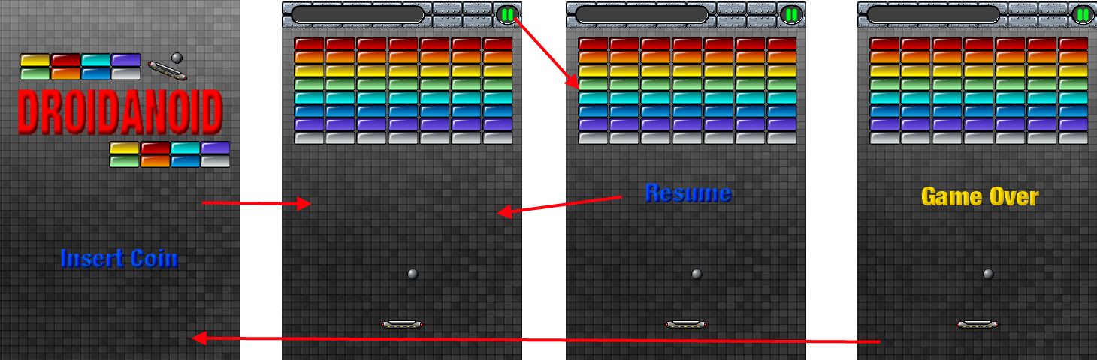
5 – Screens & Transitions
Incoming Call

Slide 140
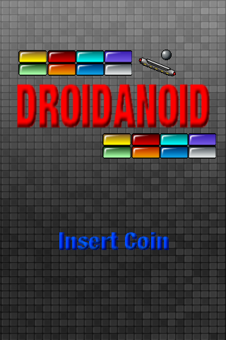
5 – Main Menu Screen
Shows a static background image with the logo.
„Insert Coin“ label is blinking with a 0.5 seconds interval.
A touch of the screen will trigger a transition to the game screen.

Slide 141
5 – Game Screen
Shows a static background image with the top bar for score display and pause button.
The blocks are individual objects.
Same for ball and paddle.
Has state:
Running
Paused
GameOver

Slide 142
5 – Game Screen
In the running state the action happens.
Game world is simulated & rendered.
Changes state to game over if ball leaves screen on the bottom edge.
Changes state to paused if home or pause button is pressed, or call is incoming.

Slide 143
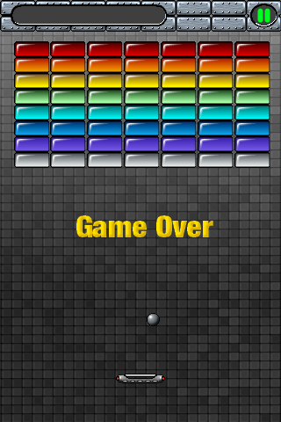
5 – Game Screen
In the game over state we display an additional game over label.
The game world is still rendered but not simulated
Waiting for user touching the screen which will trigger transition to main menu.
Note that incoming call or home button can put the game to sleep!
When player returns the screen is still in the game over state.

Slide 144
5 – Defining the Game World
Dimensions & Sizes of game world should be designed before creating assets!
We already know our assets so it‘s a bit „hen & egg“.
Let‘s pretend we don‘t have the mock-ups yet.

Slide 145
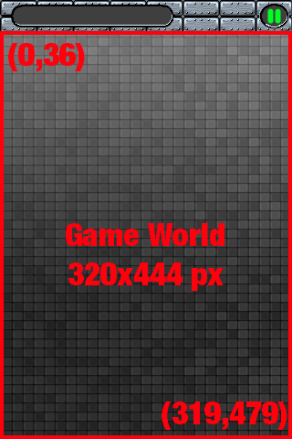
5 – Defining the Game World
Define target resolution (320x480).
Define the portion available for displaying the game world. (0,36) to (319,479) pixels == viewport.
In Droidanoid we see all of the world at once.
In other games game world portion on screen acts as viewport into our game world that we can move around.

Slide 146
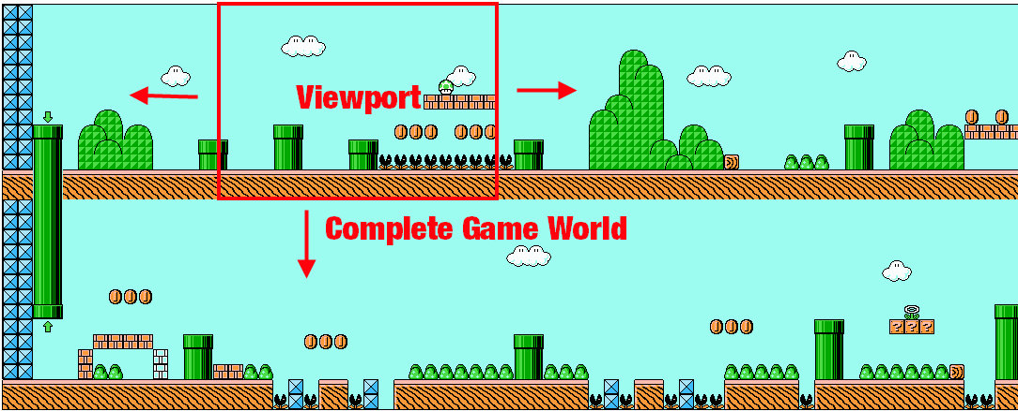
5 – Defining the Game World

Slide 147
5 – Defining the Game World
We have 3 types of objects:
Blocks
Ball
Paddle
How big should they be?
What units do we use?

Slide 148
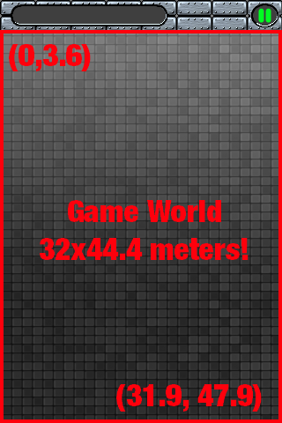
5 – Defining the Game World
We use pixels for convenience.
Note: we don‘t have to!
We could also use meters to specify the sizes, positions and velocities.
Decouple graphical representation from logical representation.

Slide 149
5 – Defining the Game World
Scale factor to translate from logical units (e.g. meters) to pixels.
In our hypothecal case that factor is 10.
Logical -> Pixel
(23, 4.78) m * 10 = (230, 47.8) px
Pixel -> Logical
(230, 47.8) px / 10 = (23, 4.78) m
We model & simulate in logical units, render in pixel units!

Slide 150
5 – Defining the Game World
How big should the objects be then!?
Trial & Error + Gut Feeling.
Sizes relative to each other must make sense (logical units).
Sizes on screen must make sense (pixel units).
„Super Mario should take up 1/5th of the viewport“

Slide 151
5 – Defining the Game World
Define target resolution (320x480).
Define viewport in pixels (320x444).
Define logical to pixel scale factor(1 meter -> 10 pixels).
Calculate viewport size in logical units (32x44.4 meters).
Define object sizes given logical viewport (block: 4x1.8m, ball: 1.5x1.5m, paddle: 5.6x1.1m)
Calculate pixels sizes from logical sizes (times 10, block: 40x18px, ball: 15x15px, paddle: 56x11px).
Create Assets!

Slide 152
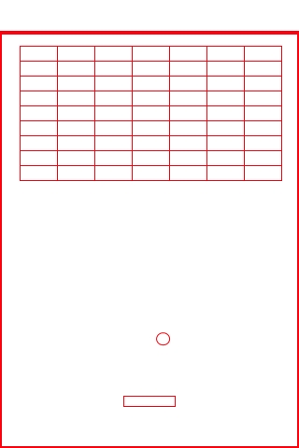
5 - Defining the Game World

Slide 153
5 – Defining the Game World
Surprise: we use pixels as logical units! _/\_
Why do i put you through this?
Seperation of graphics and logical view of game world is important!
Physics libraries force you to work in meters.
Scaling graphics doesn‘t change logical representation!
Similar to DIP in UI programming.

Slide 154
5 – Defining the Game World
Decoupling lends itself to (modified) Model-View-Controller pattern.
Model: dumb classes for
Ball.
Block.
Paddle.
Controller:
simulates world, using & updating model.
Processes and applies user input.
View: renders the current model state!

Slide 155

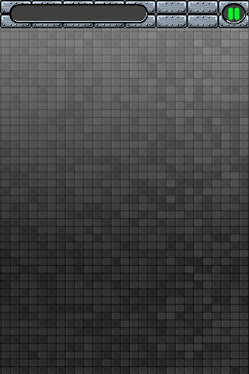
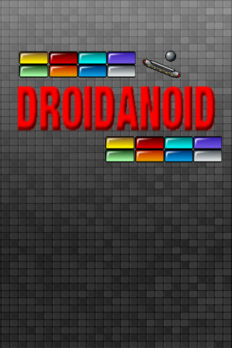



5 – Creating the Assets
blocks.png
background.png
mainmenu.png
ball.png
insertcoin.png
resume.png
gameover.png
paddle.png
Sprites by David Gervais, free for educational/non-commercial use
http://forum.thegamecreators.com/?m=forum_view&t=67876&b=1
Gray Background from (fair use).
http://www.consolespot.net/graphics-design/15371-homebrew-icon-thread.html

Slide 156
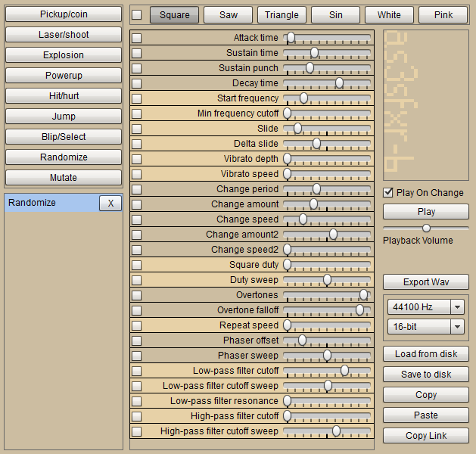
5 – Creating the Assets
For sound effects we use AS3SFXR http://ded.increpare.com/~locus/as3sfxr-b/
8-bit synth.
Fitting music from http://www.freemusicarchive.org
Obey the licenses!

Slide 157
5 – Implementing Droidanoid
Let‘s start simple by implementing the Droidanoid class.
It‘s our main entry point.
Sets the first screen shown to the player (MainMenuScreen).
public class Droidanoid extends Game {
public Screen createStartScreen() {
return new MainMenuScreen(this);
}
}

Slide 158
5 – Implementing MainMenuScreen
Screen implementation showing
The main menu background image
A blinking „Insert Coin“ label.
Label should be shown for 0.5 seconds, then be invisble for 0.5 seconds etc.
We use the delta time to figure out how much time passed for blinking.
In case screen is touched we trigger transition to GameScreen.

Slide 159
5 – Implementing the MainMenuScreen
public class MainMenuScreen extends Screen {
Bitmap mainmenu, insertCoin, ball;
float passedTime = 0;
public MainMenuScreen(Game game) {
super(game);
mainmenu = game.loadBitmap("mainmenu.png");
insertCoin = game.loadBitmap("insertcoin.png");
}
long startTime = System.nanoTime();
public void update(float deltaTime) {
if(game.isTouchDown(0)) { game.setScreen(new GameScreen(game)); return; }
passedTime += deltaTime;
game.drawBitmap(mainmenu, 0, 0);
if((passedTime - (int)passedTime) > 0.5f)
game.drawBitmap(insertCoin, 160 - insertCoin.getWidth() / 2, 360);
}
public void dispose() {}
public void pause() { }
public void resume() { }
}

Slide 160
5 – Implementing GameScreen.
Has multiple tasks to handle
Proper pause/resume.
Render UI (score, background, pause button etc.).
Simulate the game world.
Render the game world.
Let‘s implement the first two items.

Slide 161
5 – Implementing GameScreen
We have 3 states:
Running, Paused, Game Over.
We‘ll encode those with an enum.
We need to display the background and the apropriate label („Resume“, „Game Over“) depending on state.

Slide 162
5 – Implementing GameScreen
public class GameScreen extends Screen {
enum State { Paused, Running, GameOver }
Bitmap background, resume, gameOver;
State state = State.Running;
public GameScreen(Game game) {
super(game);
background = game.loadBitmap("background.png");
resume = game.loadBitmap("resume.png");
gameOver = game.loadBitmap("gameover.png");
}
…

Slide 163
5 – Implementing GameScreen
public class GameScreen extends Screen {
...
public void update(float deltaTime) {
if(state == State.Paused && game.getTouchEvents().size() > 0) {
state = State.Running;
}
if(state == State.GameOver && game.getTouchEvents().size() > 0) {
game.setScreen(new MainMenuScreen(game));
return;
}
if(state == State.Running && game.getTouchY(0) < 32 && game.getTouchX(0) > 320 - 32) {
state = State.Paused;
return;
}
game.drawBitmap(background, 0, 0);
if(state == State.Paused)
game.drawBitmap(resume, 160 - resume.getWidth() / 2, 240 - resume.getHeight() / 2);
if(state == State.GameOver)
game.drawBitmap(gameOver, 160 - gameOver.getWidth() / 2, 240 - gameOver.getHeight() / 2);
}
public void pause() {
if(state == State.Running) state = State.Paused;
}

Slide 164
5 – Implementing GameScreen
Time to implement the model, view and controller of our world.
The model is composed of classes for each object (Ball, Paddle, Block).
The controller keeps track of objects and simulates the world. Class name World.
The view is a separate class we call WorldRenderer. It takes the model and renders its current state (via Bitmaps and Game).
We‘ll develop those three things iteratively.

Slide 165
5 – Implementing GameScreen
Ball has a position (x,y) and a velocity (vx, vy).
Position equals upper left corner of ball, given in pixels
Velocity is given in pixels per second (time-based movement!).
Both attributes are actually 2D vectors!
Velocity also encodes direction in x and y!
Width and height are constants.
(vx,vy)
public class Ball {
public static float WIDTH = 15;
public static float HEIGHT = 15;
float x = 160, y = 240;
float vx = 170, vy = -170;
}
(x,y)
HEIGHT
WIDTH

Slide 166
5 – Implementing GameScreen
World class stores model (Ball only for now)
Responsible for updating and colliding objects (delta time!)
Let‘s make the Ball bounce of the walls.
public class World {
public static float MIN_X = 0, MIN_Y = 32;
public static float MAX_X = 319, MAX_Y = 479;
Ball ball = new Ball();
public void update(float deltaTime) {
ball.x += ball.vx * deltaTime;
ball.y += ball.vy * deltaTime;
if(ball.x < MIN_X) { ball.vx = -ball.vx; ball.x = MIN_X; }
if(ball.x - Ball.WIDTH > MAX_X) { ball.vx = -ball.vx; ball.x = MAX_X – Ball.WIDTH; }
if(ball.y < MIN_Y) { ball.vy = -ball.vy; ball.y = MIN_Y; }
if(ball.y - Ball.HEIGHT > MAX_Y) { ball.vy = -ball.vy; ball.y = MAX_Y – Ball.HEIGHT; }
}
}

Slide 167
5 – Implementing GameScreen
WorldRenderer has reference to World to get model state.
Game reference to load Bitmaps and draw objects.
public class WorldRenderer {
Game game;
World world;
Bitmap ballImage;
public WorldRenderer(Game game, World world) {
this.game = game;
this.world = world;
this.ballImage = game.loadBitmap("ball.png");
}
public void render() {
game.drawBitmap(ballImage, (int)world.ball.x, (int)world.ball.y);
}
}

Slide 168
5 – Implementing GameScreen
We have to add the World & WorldRenderer to GameScreen.
Call methods at appropriate place.
public class GameScreen extends Screen {
…
World world;
WorldRenderer renderer;
public GameScreen(Game game) {
...
world = new World();
renderer = new WorldRenderer(game, world);
}
public void update(float deltaTime) {
...
if( (state == State.Running) world.update(deltaTime);
game.drawBitmap(background, 0, 0);
renderer.render();
…
}

Slide 169
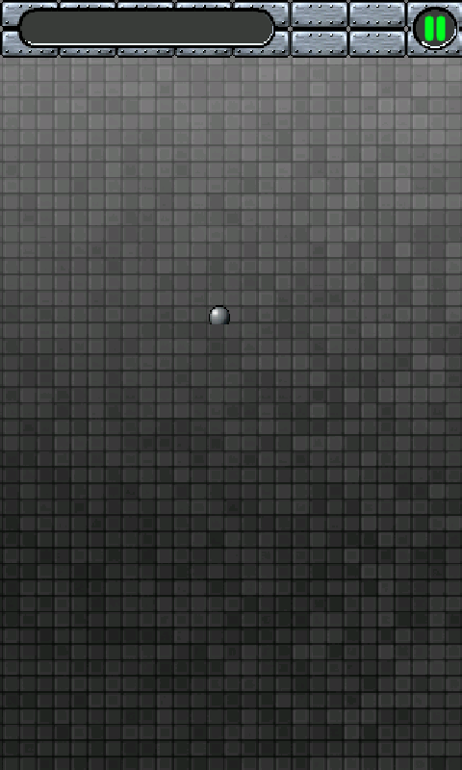
5 – Implementing GameScreen
Yay!

Slide 170
5 – Implementing GameScreen
Next up is the Paddle class.
Pretty much like Ball, dimensions differ.
Y-coordinate is fixed, we can only move in x!
Velocity comes from outside -> Acceleromter!
World is responsible for movement.
public class Paddle {
public static float WIDTH = 56;
public static float HEIGHT = 11;
float x = 160 - WIDTH / 2, y = World.MAX_Y - 40;
}

Slide 171
5 – Implementing GameScreen
Paddle is controlled by accelerometer.
Reading of x-axis is velocity of paddle!
We have to pipe accelerometer value to World so it can update Paddle.
AccelX in range [-10, 10], have to negate and scale it a little -> tuning!
public class World {
...
Paddle paddle = new Paddle();
public void update(float deltaTime, float accelX) {
...
paddle.x += -accelX * 50 * deltaTime;
if(paddle.x < MIN_X) paddle.x = MIN_X;
if(paddle.x + Paddle.WIDTH > MAX_X) paddle.x = MAX_X -Paddle.WIDTH;
}
}

Slide 172
5 – Implementing GameScreen
public class WorldRenderer {
…
Bitmap paddleImage;
public WorldRenderer(Game game, World world) {
…
this.paddleImage = game.loadBitmap("paddle.png");
}
public void render() {
…
game.drawBitmap(paddleImage, (int)world.paddle.x,(int)world.paddle.y);
}
}
public class GameScreen {
…
public void update(float deltaTime) {
...
if(state == State.Running) world.update(deltaTime, game.getAccelerometer()[0]);
...
}
}

Slide 173
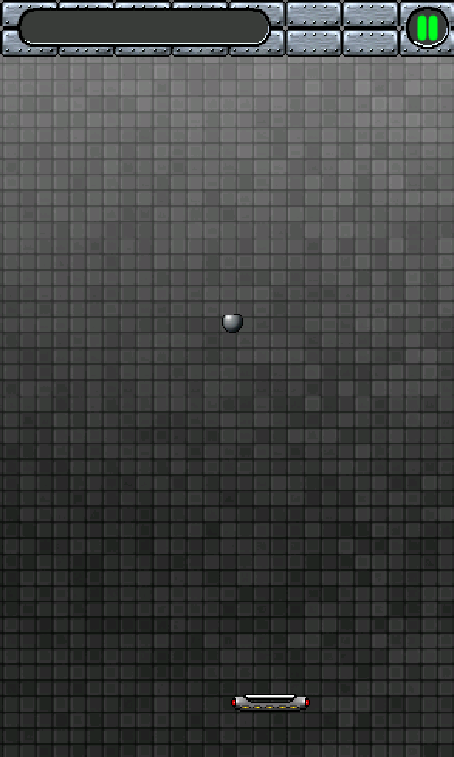
5 – Implementing GameScreen
We have paddle movement!

Slide 174
5 – Implementing GameScreen
Let us collide the ball with the paddle.
Only need to check top edge of paddle.
In case of hit, ball changes velocity/position on y-axis.
public class World {
…
public void update(float deltaTime, float accelX) {
…
collideBallPaddle();
}
private void collideBallPaddle() {
if(ball.y > paddle.y) return;
if(ball.x >= paddle.x &&
ball.x < paddle.x + Paddle.WIDTH &&
ball.y + Ball.HEIGHT >= paddle.y) {
ball.y = paddle.y - Ball.HEIGHT - 2;
ball.vy = -ball.vy;
}
}
}

Slide 175
5 – Implementing GameScreen
Time for the blocks.
We have 8 rows and 7 columns.
Each Block is its own object with a position, just like Ball or Paddle.
Depending on the row a ball has a specific color and generates a specific number of points.
We thus keep track of a blocks „type“ == row in a graphical sense.

Slide 176
5 – Implementing GameScreen
public class Block {
public static float WIDTH = 40;
public static float HEIGHT = 18;
int type;
float x, y;
public Block(float x, float y, int type) {
this.x = x;
this.y = y;
this.type = type;
}
}

Slide 177
5 – Implementing GameScreen
World keeps a list of Blocks.
We have to generate them so they form a grid of 8x7 blocks. Easy!
public class World {
...
List<Block> blocks = new ArrayList<Block>();
public World() {
generateBlocks();
}
private void generateBlocks() {
blocks.clear();
for(int y = 60, type = 0; y < 60 + 8 * Block.HEIGHT; y+= Block.HEIGHT, type++) {
for(int x = 20; x < 320 - Block.WIDTH / 2; x+= Block.WIDTH) {
blocks.add(new Block(x, y, type));
}
}
}
}

Slide 178
5 – Implementing GameScreen
In the WorldRenderer we do something called image atlasing.
„blocks.png“ contains not only one block but multiple blocks.
Depending on the type of block we have to render we chose a sub-image and only render a portion of „blocks.png“
We use Block.type to select the sub-image.
Type 0
Type 1
Type 2
Type 3
Type 4
Type 5
Type 6
Type 7

Slide 179
5 – Implementing GameScreen
public class WorldRenderer {
…
Bitmap blocksImage;
public WorldRenderer(Game game, World world ) {
this.blocksImage = game.loadBitmap("blocks.png");
}
public void render() {
…
for(int i = 0; i < world.blocks.size(); i++) {
Block block = world.blocks.get(i);
game.drawBitmap(blocksImage, (int)block.x, (int)block.y,
0, (int)(block.type * Block.HEIGHT),
(int)Block.WIDTH, (int)Block.HEIGHT);
}
}
}

Slide 180
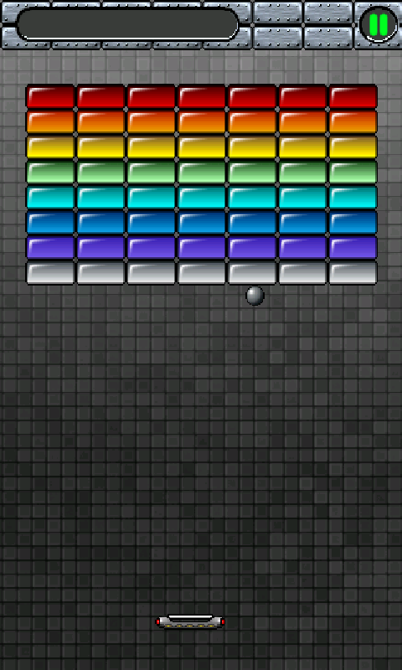
5 – Implementing GameScreen

Slide 181
5 – Implementing GameScreen
Plan of Attack for collision between ball & blocks:
Figure out if the ball overlaps with a block.
In case it does change the velocity of the ball and remove the block from the world.
Corner cases (multiple blocks hit at a time).
Let‘s start by checking for overlaps and simply remove a hit block without changing ball velocity.

Slide 182
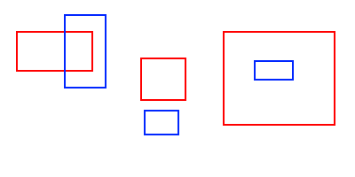
5 – Implementing GameScreen
Ball and blocks are rectangles for simplicity.
How can rectangles overlap?

Slide 183
5 – Implementing GameScreen
Public class World {
public void update(float deltaTime, float accelX) {
…
collideBallBlocks();
}
private boolean collideRects(float x, float y, float width, float height,
float x2, float y2, float width2, float height2) {
if(x < x2 + width2 &&
x + width > x2 &&
y < y2 + height2 &&
y + width > y2)
return true;
return false;
}
private void collideBallBlocks() {
for(int i = 0; i < blocks.size(); i++) {
Block block = blocks.get(i);
if(collideRects(ball.x, ball.y, Ball.WIDTH, Ball.HEIGHT,
block.x, block.y, Block.WIDTH, Block.HEIGHT)) {
blocks.remove(i);
i--;
}
}
}

Slide 184
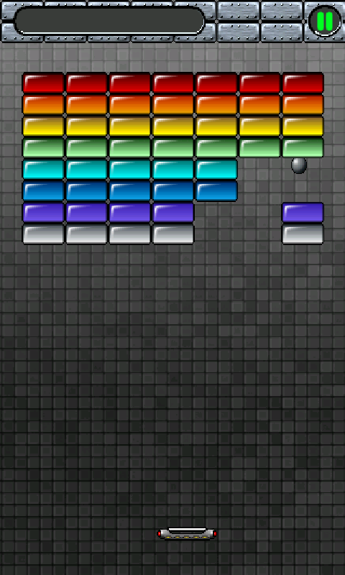
5 – Implementing GameScreen

Slide 185
5 – Implementing GameScreen
Now we need to let the ball react to a collision.
We‘ll simply reflect its velocity based on which side of a block it hit.
Not so clear cut though.

Slide 186
5 – Implementing GameScreen
We need to check all 4 corners first.
If that fails we check the four edges.
We use World.collideRects() using very thin rectangles for edges and corner points.

Slide 187
5 – Implementing GameScreen
Public class World {
...
private void collideBallBlocks() {
for(int i = 0; i < blocks.size(); i++) {
Block block = blocks.get(i);
if(collideRects(ball.x, ball.y, Ball.WIDTH, Ball.HEIGHT,
block.x, block.y, Block.WIDTH, Block.HEIGHT)) {
float oldvx = ball.vx;
float oldvy = ball.vy;
reflectBall(ball, block);
ball.x = ball.x - oldvx * deltaTime * 1.01f;
ball.y = ball.y - oldvy * deltaTime * 1.01f;
}
}
}
public void reflectBall(Ball ball, Block block) { … };
...
}

Slide 188
5 – Implementing GameScreen
Regenerate blocks if all blocks are destroyed.
Public class World {
...
private void update(float deltaTime, float accelX) {
if(blocks.size() == 0) generateBlocks();
...
}
...
}

Slide 189
5 – Implementing GameScreen
Game Over Check (with flag)!
public class World {
...
boolean gameOver = false;
private void update(float deltaTime, float accelX) {
if(ball.y > MAX_Y - Ball.HEIGHT) { gameOver = true; return; }
...
}
...
}
public class GameScreen {
...
private void update(float deltaTime) {
if(world.gameOver) state = State.GameOver;
...
}
...
}

Slide 190
5 – Implementing GameScreen
There‘s a bug in GameScreen!
We should really check for a touch up event before we change to the MainMenuScreen.
public class GameScreen {
...
private void update(float deltaTime, float accelX) {
...
if(state == State.GameOver) {
List<TouchEvent> events = game.getTouchEvents();
for(int i = 0; i < events.size(); i++) {
if(events.get(i).type == TouchEvent.TouchEventType.Up) {
game.setScreen(new MainMenuScreen(game));
return;
}
}
}
...
}
...
}

Slide 191
5 – Implementing GameScreen
We should also keep track of points!
Depending on block type we give 10, 9, 8 etc. points.
public class World {
...
int points = 0;
private void collideBallBlocks(float deltaTime) {
for(int i = 0; i < blocks.size(); i++) {
Block block = blocks.get(i);
if(collideRects(ball.x, ball.y, Ball.WIDTH, Ball.HEIGHT,
block.x, block.y, Block.WIDTH, Block.HEIGHT)) {
...
points += 10 - block.type;
break;
}
}
}
}

Slide 192
5 – Implementing GameScreen
How do we render the score?
Could use image atlas for glyphs (~ characters).
Instead we use Android fonts with Canvas!
Typeface Game.loadFont(String fileName);
Game.drawText(Typeface font, String text, int x, int y, int col, int size);

Slide 193
5 – Implementing GameScreen
public abstract class Game extends Activity implements Runnable, OnKeyListener, SensorEventListener {
Paint paint = new Paint();
public Typeface loadFont(String fileName) {
Typeface font = Typeface.createFromAsset(getAssets(), fileName);
if(font == null)
throw new RuntimeException("Couldn't load font from asset '" + fileName + "'");
return font;
}
public void drawText(Typeface font, String text, int x, int y, int col, int size) {
paint.setTypeface(font);
paint.setTextSize(size);
paint.
canvas.drawText(text, x, y + size, paint);
}
}

Slide 194
5 – Implementing GameScreen
public class GameScreen extends Screen {
…
Typeface font;
public GameScreen(Game game) {
font = game.loadFont(„font.ttf“);
}
public void update(float deltaTime) {
…
game.drawText(font, Integer.toString(world.points), 24, 12, Color.GREEN, 12);
}
}

Slide 195
5 – Implementing Audio
Sound is missing!
Let‘s add looping music.
public class Droidanoid extends Game {
Music music;
public Screen createStartScreen() {
music = this.loadMusic("music.ogg“);
return new MainMenuScreen(this);
}
public void onPause() {
super.onPause();
music.pause();
}
public void onResume() {
super.onResume();
music.play();
}
}

Slide 196
5 – Implementing Audio
Who‘s responsible for playing back soundeffects?
World knows when collisions happen but shouldn‘t play sounds!
Solution: interface CollisionListener
public interface CollisionListener {
public void collisionWall();
public void collisionPaddle();
public void collisionBlock();
}

Slide 197
5 – Implementing Audio
CollisionHandler is called whenever ball collides with something in World.
public class World {
CollisionListener listener;
public World(CollisionListener listener) {
...
this.listener = listener;
}
...
}

Slide 198
5 – Implementing Audio
Load the sound effects in GameScreen.
Register CollisionListener with World
Plays back sound effects!
Public class GameScreen extends Screen {
...
Sound bounceSound, blockSound;
public GameScreen(Game game) {
...
bounceSound = game.loadSound("bounce.wav");
blockSound = game.loadSound("blocksplosion.wav");
world = new World(new CollisionListener() {
public void collisionWall() { bounceSound.play(1); }
public void collisionPaddle() { bounceSound.play(1); }
public void collisionBlock() { blockSound.play(1); }
});
...
}

Slide 199
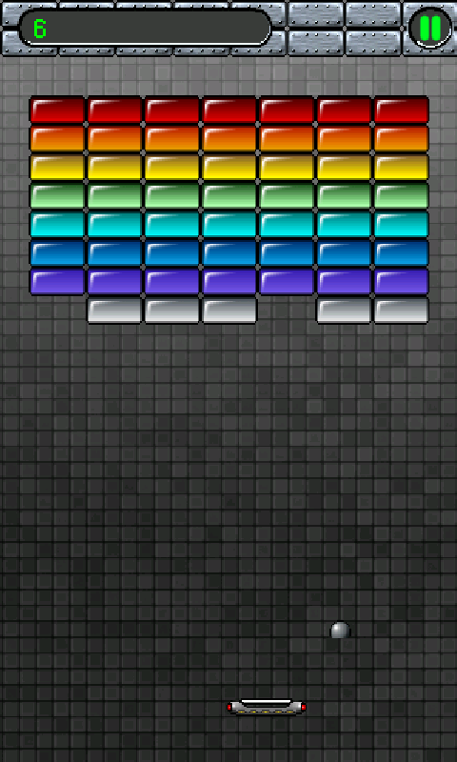
Fin
Polish!
Make a real game out of it!
Different block layouts.
Power ups.
More control schemes.
Optimizations
Memory allocation? (Score string)
Profiling with DDMS.

Slide 200
Engines & Framworks
Unreal Development Kit (http://www.udk.com/): A commercial game engine running on a multitude of platforms, developed by Epic Games. Those guys made games like Unreal Tournament so it’s quality stuff. Uses its own scripting language.
Unity3D (http://unity3d.com/): Another commercial game engine with great tools and functionalty. It too works on a multitude of platforms, like IOS, Android or in the browser and is easy to pick up. Allows a couple of languages for coding the game logic, Java is not among them.
jPCT-AE (http://www.jpct.net/jpct-ae/): a port of the Java-based jPCT engine for Android. Has some great features with regards to 3D programming. Works on the desktop and on Android. Closed-source.
Ardor3D (http://www.jpct.net/jpct-ae/): a very powerful Java-based 3D engine. Works on Android and on the desktop, open-source with great documentation.
libgdx (http://code.google.com/p/libgdx/): an open-source Java-based game development framework by yours truly, for 2D and 3D games. Works on the Windows, Linux, OSX and of course Android without any code modifications. Develop and test on the desktop without the need for an attached device or the slow emulator.
Slick-AE (http://slick.cokeandcode.com/): a port of the Java-based Slick framework to Android, build on top of libgdx. Tons of functionality and easy to use API for 2D game development. Cross-platform and open-source of course.
AndEngine (http://www.andengine.org/): a nice, Java-based Android-only 2D engine, partially based on libgdx code (open source for the win!). Similar in concept to the famous Cocos2D game development engine for IOS.

Slide 201
References
http://gamedev.net
http://wiki.gamedev.net
http://www.flipcode.com/archives/
http://www.java-gaming.org/
http://www.gamasutra.com
http://www.google.com

